Slide 1
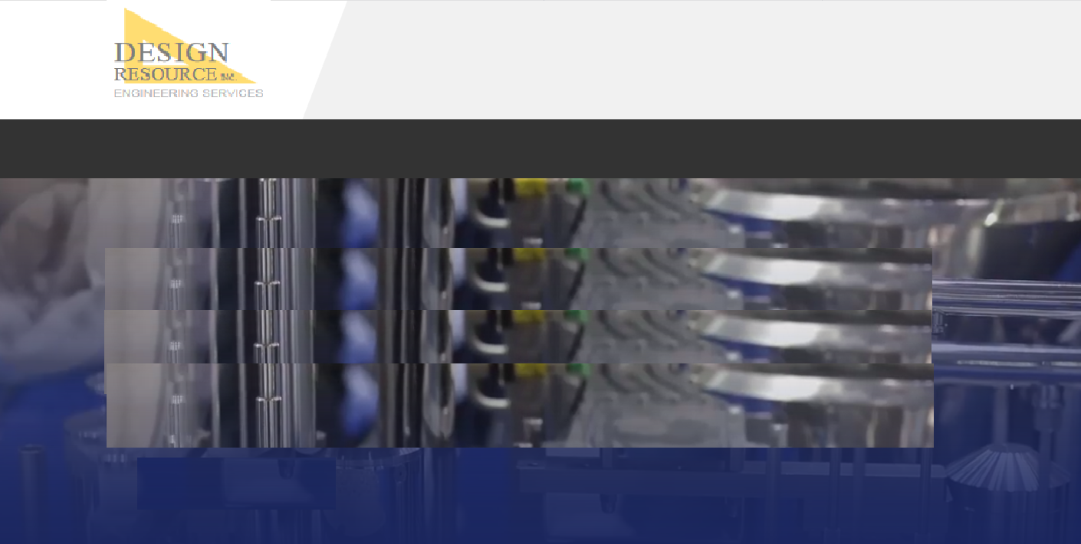

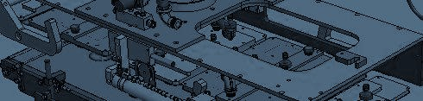
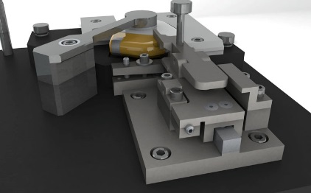
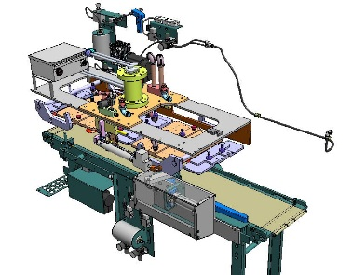
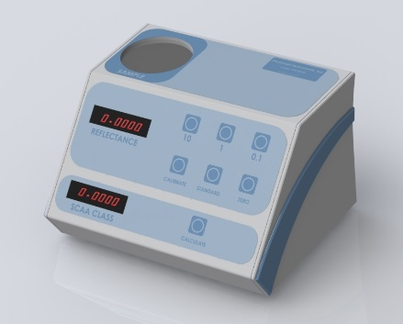


Value driven. Quality sustained.
Contact us
HOME ENGINEERING STAFFING COMPANY CONTACT
Complete product design and manufacturing solutions from concept through build.
Design Resource provides robust, innovative engineering services to help you grow and achieve your goals.
Tooling and Fixture Design
We provide unique and robust solutions for difficult fixturing and assembly challenges. We specialize in precision medical and high tech tooling solutions including laser and RSW weld tooling..
Manufacturing Engineering and Machine Design
We develop and build specialty machines to help our customers achieve their manufacturing goals, including automation and full controls integration.
Product Development
From concept through prototype, our team will work with you bring your product to market using a streamlined, efficient approach.
Learn More
Learn More
Learn More
HOME | ENGINEERING | STAFFING | COMPANY | CONTACT
© 2019 DESIGN RESOURCE, INC.

Slide 2
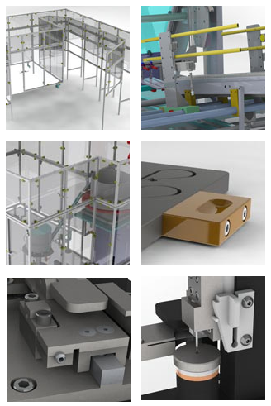
Value driven. Quality sustained.
Contact us
HOME ENGINEERING STAFFING COMPANY CONTACT
Manufacturing Engineering
Complete turnkey manufacturing solutions to bring your project from initial concept through final build.
Machine design
Intermittent or continuous motion
Motion control systems
Work cells or lines
Material handling
Control system layout and design
Safety enclosures
PLC programming
Tooling and Fixtures
Robust solutions for the toughest positioning and assembly problems.
Clean room tooling (medical and high tech)
Assembly tooling
RSW tooling
Laser Weld tooling
Inspection tooling
Mechanism Design
Process and manufacturing equipment
Process development
Learn More
HOME | ENGINEERING | STAFFING | COMPANY | CONTACT
© 2019 DESIGN RESOURCE, INC.

